Slide 1
Transmission Modes, Multiplexing & Channelization
CSC 223

Slide 2
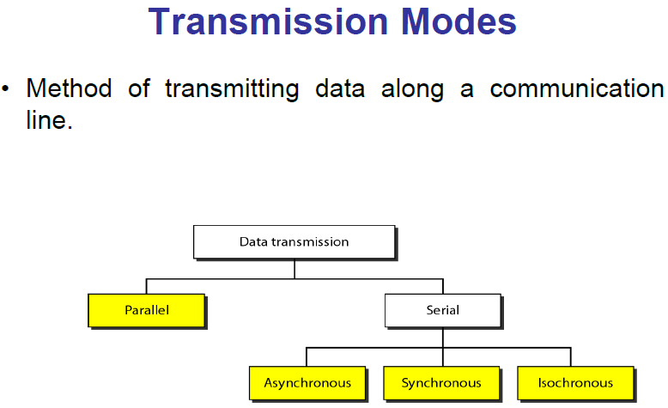

Slide 3
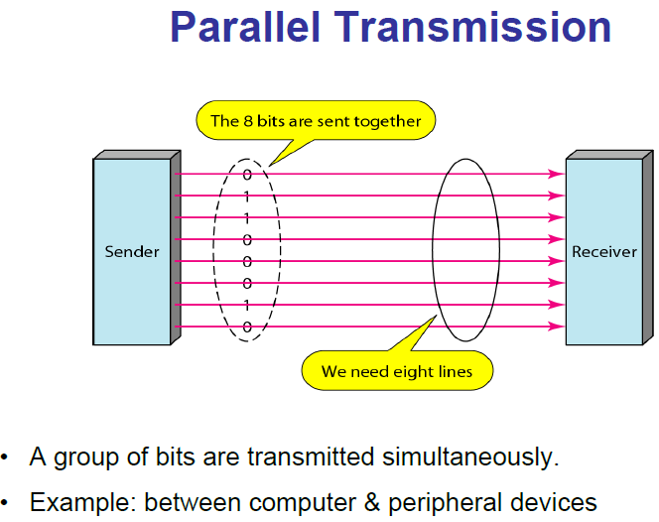

Slide 4
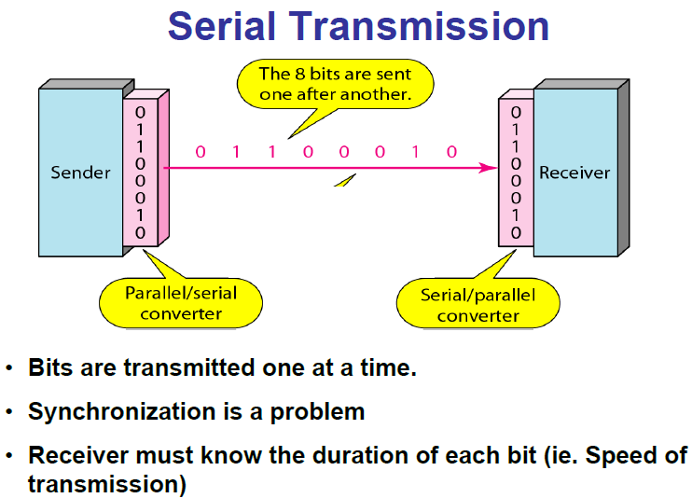

Slide 5
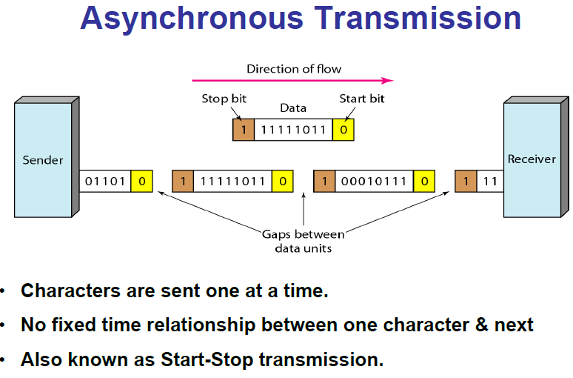

Slide 6
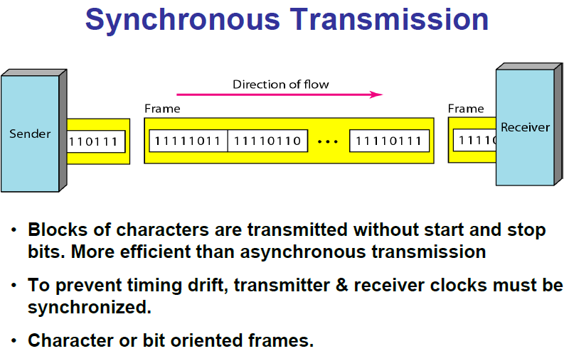

Slide 7
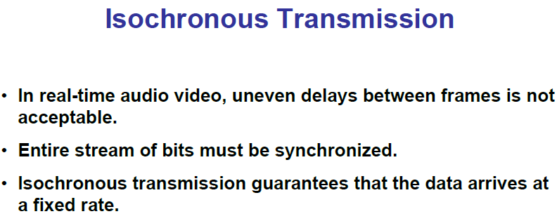

Slide 8
Multiplexing
Multiplexing is the name given to techniques, which allow more than one message to be transferred via the same communication channel.
The channel in this context could be a transmission line, e.g. a twisted pair or co-axial cable, a radio system or a fibre optic system etc.

Slide 9
To combine multiple signals (analog or digital) for transmission over a single line or media. A common type of multiplexing combines several low-speed signals for transmission over a single high-speed connection.
Multiplexing is done by using a device called multiplexer (MUX) that combines n input lines to generate one output line i.e. (many to one). Therefore multiplexer (MUX) has several inputs and one output.
At the receiving end, a device called demultiplexer (DEMUX) is used that separates signal into its component signals. So DEMUX has one input and several outputs.

Slide 10
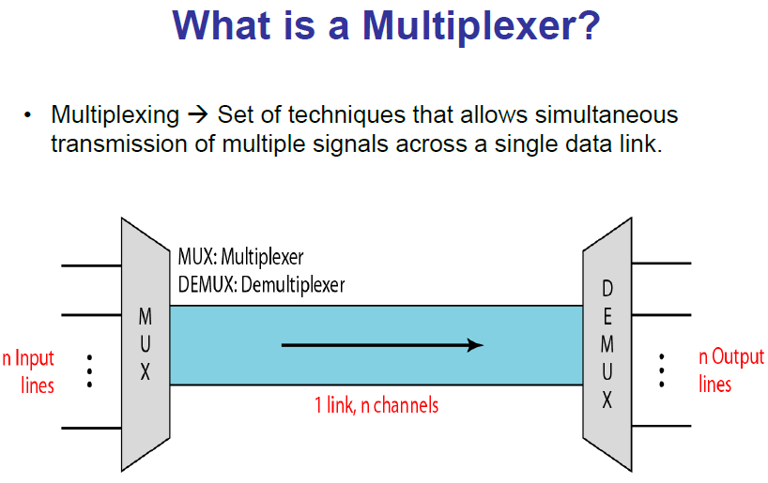

Slide 11
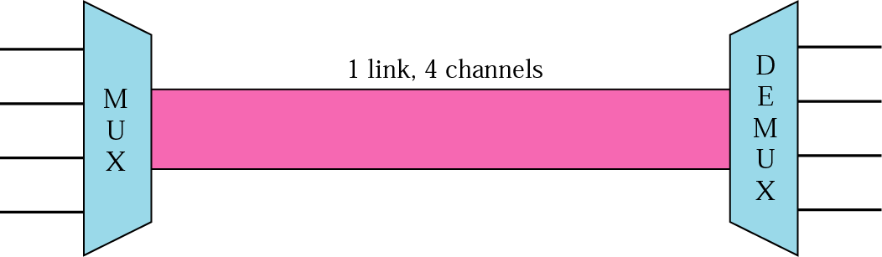
Multiplexer (MUX)
Combines multiple streams into a single stream (many to one).
Demultiplexer (DEMUX)
Separates the stream back into its component transmission (one to many) and directs them to their correct lines.

Slide 12
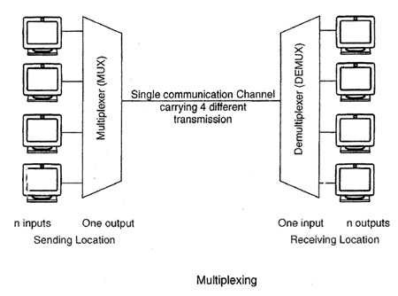

Slide 13
Multiplexer takes 4 input lines and diverts them to single output line.
The signal from 4 different devices is combined and carried by this single line.
At the receiving side, a demultiplexer takes this signal from a single line & breaks it into the original signals and passes them to the 4 different receivers.

Slide 14
If no multiplexing is used between the users at two different sites that are distance apart, then separate communication lines would be required
This is not only costly but also become difficult to manage. If multiplexing is used then, only one line is required. This leads to the reduction in the line cost and also it would be easier to keep track of one line than several lines.

Slide 15
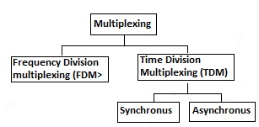
Categories of multiplexing

Slide 16
FREQUENCY-DIVISION MULTIPLEXING (FDM)
In FDM, signals generated by each sending device modulate different carrier frequencies. These modulated signals are then combined into a single composite signal that can be transported by the link. The carrier frequencies have to be different enough to accommodate the modulation and demodulation signals.

Slide 17
FDM
Signals of each channel are modulated onto different carrier signal
The resulting modulated signals are then combined into a single composite signal that is sent out over a media link
The link should have enough bandwidth to accommodate it

Slide 18
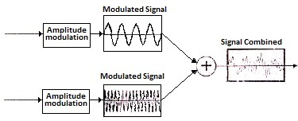
FDM multiplexing process

Slide 19
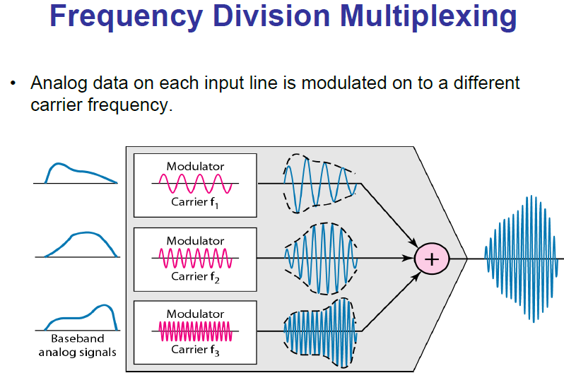

Slide 20
Demultiplexing
In demultiplexing process, filters are used to decompose the multiplexed signal into its constituent component signals.
Then each signal is passed to an amplitude demodulation process to separate the carrier signal from the message signal.
Then, the message signal is sent to the waiting receiver

Slide 21
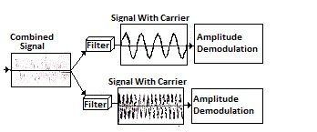
Demultiplexing

Slide 22
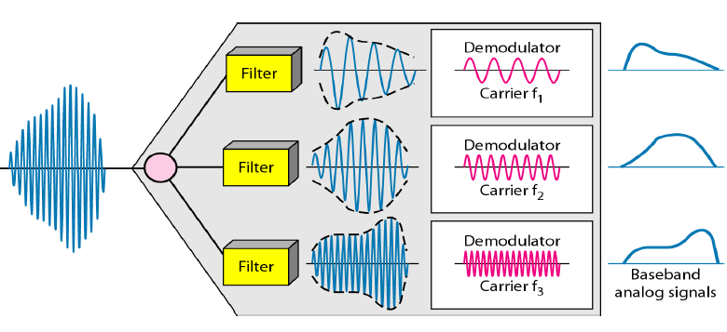
FDM demultiplexing example

Slide 23
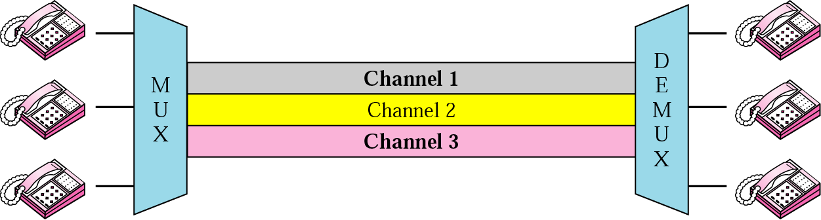
FDM

Slide 24
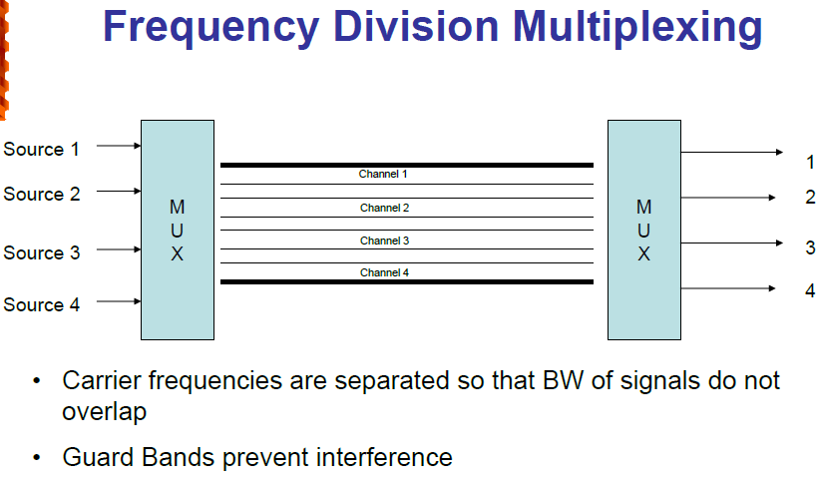

Slide 25
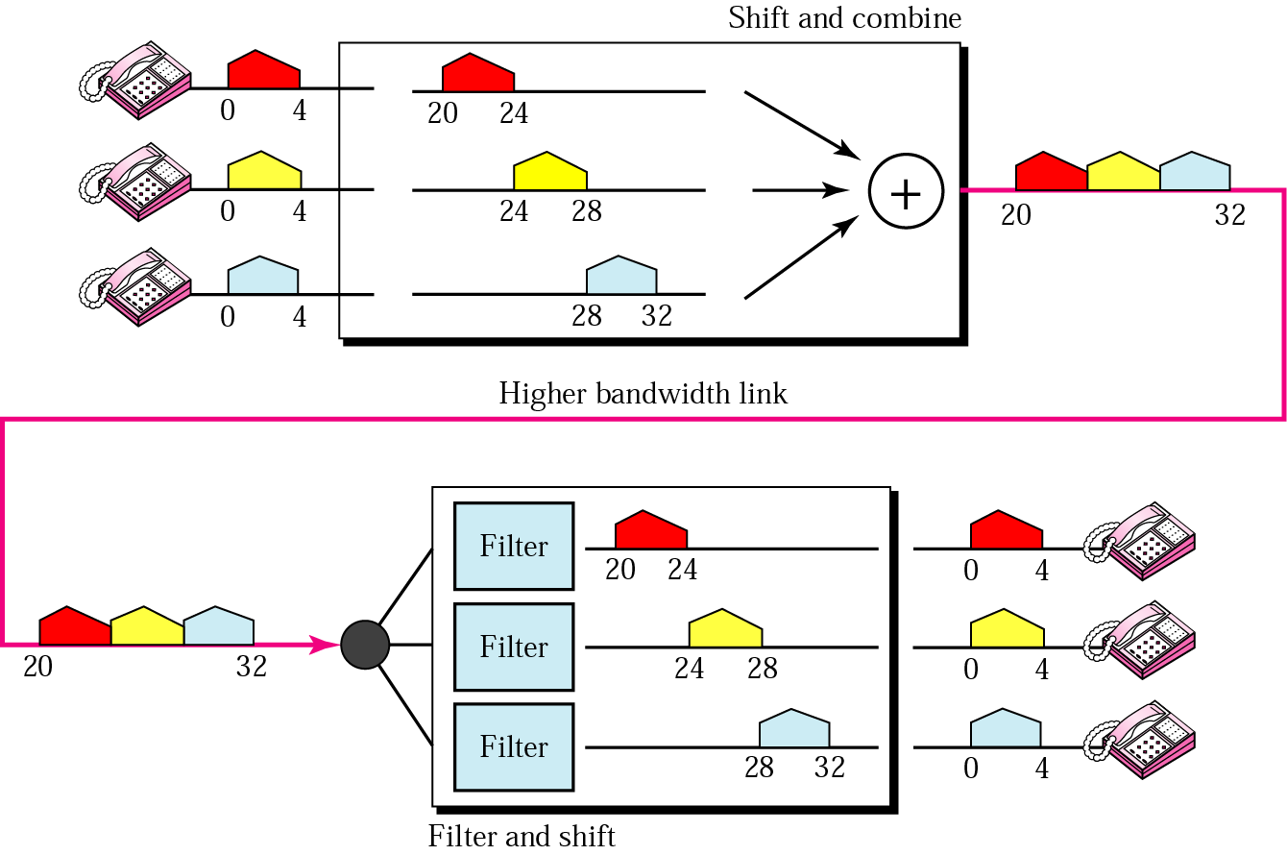

Slide 26
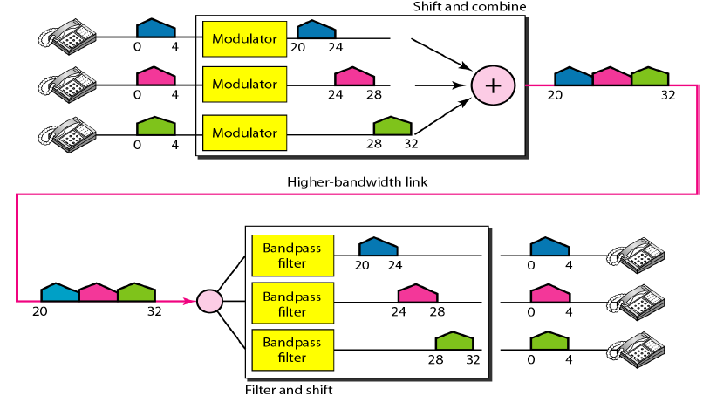
Example

Slide 27
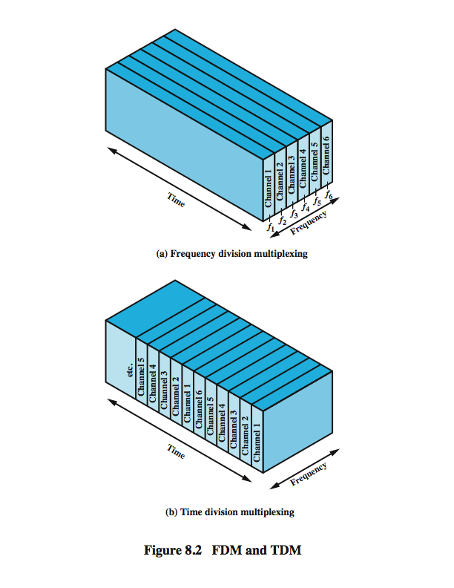

Slide 28
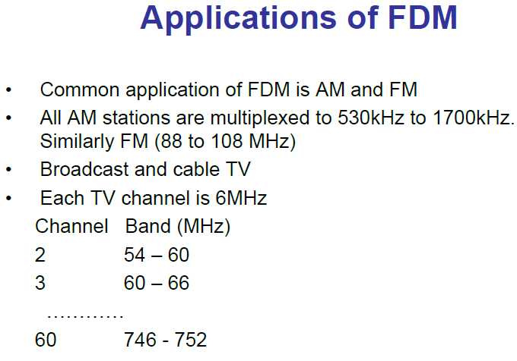

Slide 29
Time Division Multiplexing
Combines data streams by assigning each stream a different time slot in a set. TDM repeatedly transmits a fixed sequence of time slots over a single transmission channel.
In the time-division multiplexing, multiple transmissions can occupy a single link by subdividing them and interleaving the portions.
TDM is derived from sampling techniques in which messages occupy all the channel bandwidth but for short time intervals of time, i.e. the messages share the channel time.

Slide 30
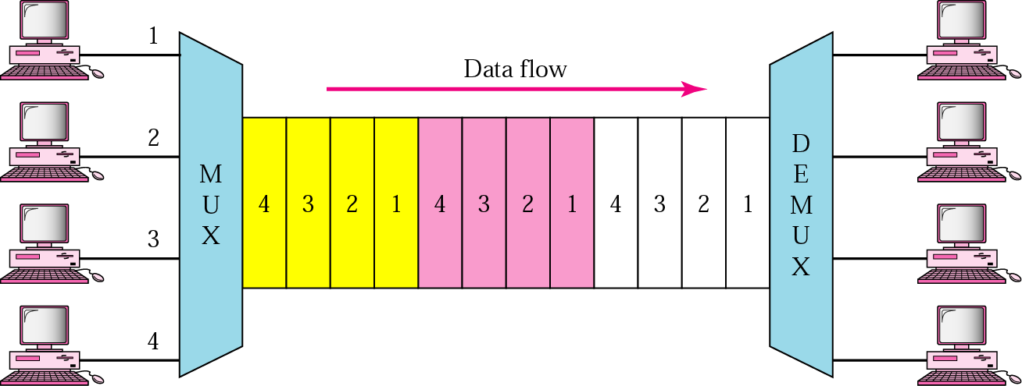
Each terminal/host given a “slice” of time (time slot)
In TDM, a frame consists of one complete cycle of time slots, with one slot dedicated to each sending device

Slide 31
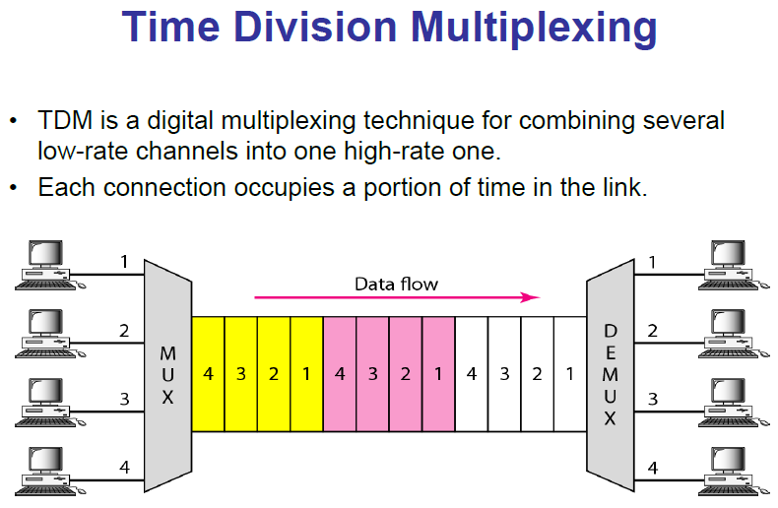

Slide 32
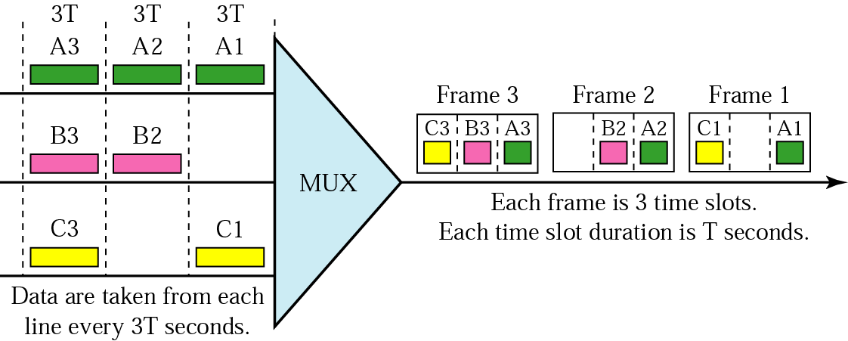
TDM

Slide 34
FDM – messages occupy narrow bandwidth – all the time.
TDM – messages occupy wide bandwidth – for short intervals of time
TDM can be implemented in two ways: synchronous TDM and asynchronous TDM.

Slide 35
Synchronous TDM
The multiplexer allocates exactly the same time slot to each device at all times, whether or not a device has anything to transmit.
Time slot 1, for example, is assigned to device 1 alone and cannot be used by any other device

Slide 36
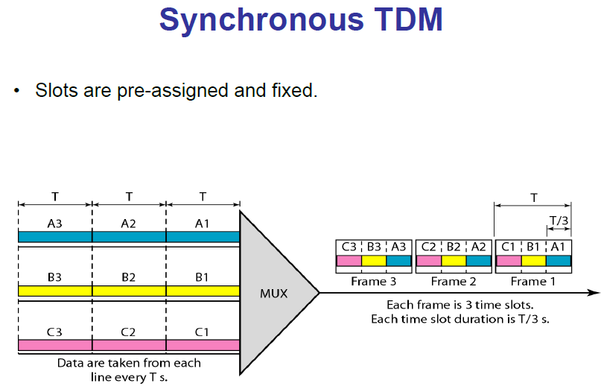

Slide 37
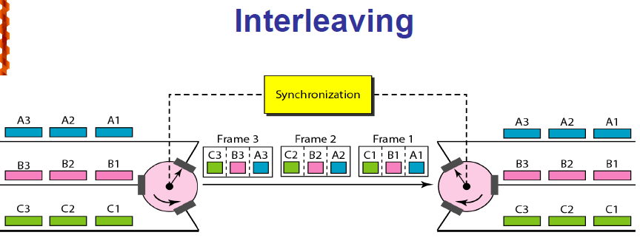

Slide 38
Asynchronous TDM
In asynchronous TDM, each slot in a frame is not dedicated to the fix device. Each slot contains an index of the device to be sent to and a message. Thus, the number of slots in a frame is not necessary to be equal to the number of input devices.
More than one slot in a frame can be allocated for an input device Asynchronous TDM allows maximization the link. It allows a number of lower speed input lines to be multiplexed to a single higher speed line.

Slide 39
Channelization
Channelization (or channel partition, as it is sometimes called) is a multiple-access method in which the available bandwidth of a link is shared in time, frequency, or through code, among different stations.
There are three channelization protocols: FDMA, TDMA, and CDMA.

Slide 40
FDMA
In frequency-division multiple access (FDMA), the available bandwidth is divided into frequency bands.
Each station is allocated a band to send its data. In other words, each band is reserved for a specific station, and it belongs to the station all the time.
Each station also uses a bandpass filter to confine the transmitter frequencies. To prevent station interferences, the allocated bands are separated from one another by small guard bands.

Slide 41
In FDMA, the available bandwidth of the common channel is divided into bands that are separated by guard bands.
FDMA specifies a predetermined frequency band for the entire period of communication. This means that stream data (a continuous flow of data that may not be packetized) can easily be used with FDMA.

Slide 42
Difference between FDMA & FDM
FDM, is a physical layer technique that combines the loads from low bandwidth channels and transmits them by using a high-bandwidth channel. The channels that are combined are low-pass. The multiplexer modulates the signals, combines them, and creates a bandpass signal. The bandwidth of each channel is shifted by the multiplexer.

Slide 43
FDMA, on the other hand, is an access method in the data-link layer. The datalink layer in each station tells its physical layer to make a bandpass signal from the data passed to it.
The signal must be created in the allocated band. There is no physical multiplexer at the physical layer. The signals created at each station are automatically bandpass-filtered. They are mixed when they are sent to the common channel.

Slide 44
TDMA
In time-division multiple access (TDMA), the stations share the bandwidth of the channel in time. Each station is allocated a time slot during which it can send data. Each station transmits its data in its assigned time slot.
The main problem with TDMA lies in achieving synchronization between the different stations. Each station needs to know the beginning of its slot and the location of its slot.
In TDMA, the bandwidth is just one channel that is timeshared between different stations.

Slide 45
Differences between TDMA & TDM
TDM, is a physical layer technique that combines the data from slower channels and transmits them by using a faster channel. The process uses a physical multiplexer that interleaves data units from each channel

Slide 46
TDMA, on the other hand, is an access method in the data-link layer. The data-link layer in each station tells its physical layer to use the allocated time slot. There is no physical multiplexer at the physical layer.

Slide 47
CDMA
Code-division multiple access (CDMA) was conceived several decades ago. Recent advances in electronic technology have finally made its implementation possible.
CDMA differs from FDMA in that only one channel occupies the entire bandwidth of the link. It differs from TDMA in that all stations can send data simultaneously; there is no timesharing.
In CDMA, one channel carries all transmissions simultaneously.

Slide 48
Analogy
CDMA simply means communication with different codes. For example, in a large room with many people, two people can talk privately in English
if nobody else understands English. Another two people can talk in Chinese if they are the only ones who understand Chinese, and so on.
In other words, the common channel, the space of the room in this case, can easily allow communication between several couples, but in different languages (codes).

